Slide 1
Nonsteroidal MRAs as part of the comprehensive approach to CKD: Guideline updates
Beatriz Fernández-Fernández
Servicio de Nefrología e Hipertensión, Hospital Universitario Fundación Jiménez Díaz
Madrid, Spain
Date of preparation: June 2023
MA-M_FIN-ALL-1232-1, MA-M_FIN-IT-0074-1
Bayer sponsored symposium

Slide 2
Disclosures: Beatriz Fernández-Fernández
Placeholder for speaker photo
Reports consultancy or speaker fees or travel support from:
AstraZeneca
Bayer
Menarini
Novo-Nordisk
Boehringer Ingelheim
Mundipharma

Slide 3
Therapies to reduce CV risk and slow CKD progression associated with T2D have evolved over the past 40 years
ARBs
Antihypertensive treatment
IDNT: N Engl J Med 2001
RENAAL: N Engl J Med 2001
Nonsteroidal MRAs
Kidney function (ml/min/year)
Long-term antihypertensive treatment: BMJ 1982
FIDELIO-DKD: N Engl J Med 2020
FIGARO-DKD: N Engl J Med 2021
ACEis
Captopril trial: N Engl J Med 1993
SGLT-2is
Glycaemic control*
CREDENCE: N Engl J Med 2019
DAPA-CKD: N Engl J Med 2020
EMPA-KIDNEY: N Engl J Med 2023
DCCT: Diabetes Care 1990
No specific therapy for CKD
Recent findings on the cardiorenal benefits of finerenone and SGLT-2is have changed the therapeutic landscape for CKD and T2D
Notes:
Long-term antihypertensive treatment: Mogensen CE. Br Med J (Clin Res Ed) 1982;285:685–688
DCCT: DCCT Research Group. Diabetes Care 1990;13:427–433
Captopril trial: Lewis EJ, et al. N Engl J Med 1993;329:1456–1462
IDNT: Lewis EJ, et al. N Engl J Med 2001;345:851–860
RENAAL: Brenner BM, et al. N Engl J Med 2001;345:861–869
CREDENCE: Perkovic V, et al. N Engl J Med 2019;380:2295–2306
DAPA-CKD: Heerspink HJL, et al. N Engl J Med 2020;383:1436–1446
EMPA-KIDNEY: The EMPA-KIDNEY Collaborative Group, et al. N Engl J Med. 2023;388:117–127
FIDELIO-DKD: Bakris GL, et al. N Engl J Med 2020;383:2219–2229
FIGARO-DKD: Pitt B, et al. N Engl J Med 2021;385:2252–2263

Slide 4
Despite RAAS blockade and SGLT-2 inhibition, patients with T2D and advanced CKD remain at risk of CKD progression
CREDENCE: Canagliflozin (+ ACEi/ARB) vs placebo¹
DAPA-CKD: Dapagliflozin (+ACEi/ARB) vs placebo (T2D subgroup)²
30
24
HR=0.57 (95% CI 0.45–0.73)
HR=0.70 (95% CI 0.59–0.82) p=0.00001
25
20
20
16
Patients with an event (%)
Patients with an event (%)
15
12
10
Placebo
8
Placebo
Canagliflozin
Residual
risk
Dapagliflozin
Residual
risk
5
4
0
0
0
6
12
18
24
30
36
42
0
4
8
12
16
20
24
28
32
Months
Months
Patients with moderately increased albuminuria: 11% Patients with severely increased albuminuria: 88% Median UACR: 927 mg/g
Patients with severely increased albuminuria: 89.7%
Median UACR: 949 mg/g
Primary composite outcome:
Kidney failure, doubling of SCr or death from kidney/CV causes
Secondary composite renal outcome: Sustained ≥50% eGFR decline, ESKD or renal death
4

Slide 5
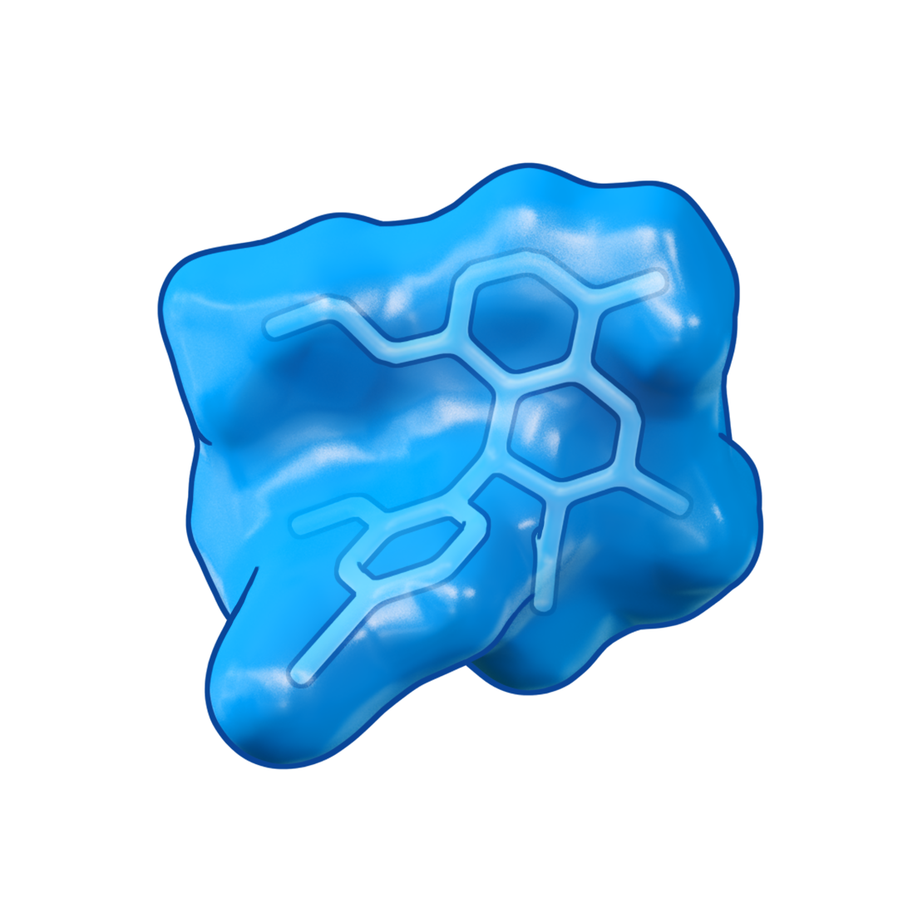
Finerenone is a first-in-class nonsteroidal MRA with clinically proven kidney and CV benefits^{1–5}
Almost 1 million molecules screened
Molecules identified and refined
N
Finerenone (BAY 94-8862)
A nonsteroidal MRA with high selectivity and potency for the MR
Finerenone identified
H₂N
N
N
H
In phase III studies, finerenone showed CV and kidney benefits in patients with CKD and T2D treated with a maximum tolerated dose of RASi^{4,5}
Finerenone tested
⁴
⁵

Slide 6
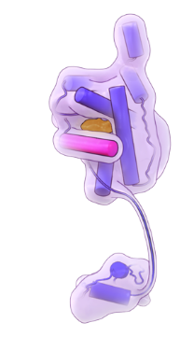
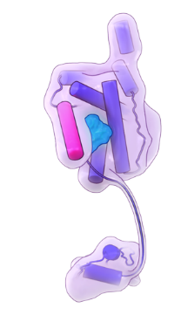
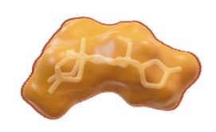
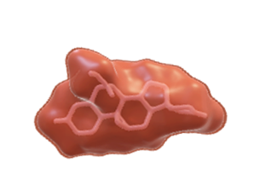
Finerenone and steroidal MRAs have key pharmacodynamic and pharmacokinetic differences^{1–3}
Aldosterone antagonists
Finerenone
Pre-clinical data
Spironolactone
Eplerenone
Finerenone
Clinical data
Structural properties | Flat (steroidal) | Flat (steroidal) |  | Bulky (nonsteroidal)
Potency against MR | +++ | + |  | +++
Selectivity for MR | + | ++ |  | +++
CNS penetration | + | + |  | –
Half-life | >20 hours* | 4–6 hours* |  | 2–3 hours#
Active metabolites | ++ | – |  | –
Breast-related side effects | ++ | (+) |  | –
Effect on BP | +++ | ++ |  | +
Indication (SmPC)
Congestive HF⁴
HF and LVEF ≤40% or ≤30%⁵
CKD associated with T2D^{6,7}

Slide 7
In the phase II ARTS trial, finerenone was associated with lower rates of hyperkalaemia* than spironolactone¹
In part B of the ARTS (phase II) trials, patients had CKD (eGFR 30–60 ml/min/1.73 m²) and HFrEF
29 (±2) days’ treatment
Patients with an investigator-reported TEAE* (%)
(n=65)
(n=66)
(n=67)
(n=67)
(n=64)
#
(n=63)
Finerenone
The results from ARTS are reinforced by a meta-analysis that found that finerenone had a lower relative risk of hyperkalaemia compared with spironolactone and eplerenone ^{‡,2}
Spironolactone RR=4.58
95% CI 2.60–8.08; p<0.00001
Eplerenone RR=2.81
95% CI 1.03–7.69; p=0.04
Finerenone RR=2.22
95% CI 0.13–38.13; p=0.58
7
Notes:
DC: Zuo_International Journal of Clinical Practice_2019 p6A, p8A-C

Slide 8
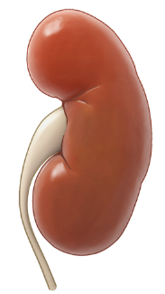
Finerenone has demonstrated significant risk reductions in CV and kidney outcomes in two phase III clinical trials
14%
reduced risk of CV morbidity and mortality (HR=0.86; 95% CI 0.78–0.95; p=0.002)¹
23%
reduced risk of CKD progression# (HR=0.77; 95% CI 0.67–0.88; p=0.0002)¹
Prespecified pooled analysis
of data from the
FIDELIO-DKD and FIGARO-DKD trials
>13,000 patients across the disease continuum of CKD and T2D (CKD stage 1–4) with moderate-to-severely elevated albuminuria (UACR ≥30 mg/g)
22%
reduced risk of first HHF* (HR=0.78; 95% CI 0.66–0.92; p=0.003)¹
20%
reduced risk of ESKD (HR=0.80; 95% CI 0.64–0.99; p=0.040)^{1,‡}
32%
reduction in UACR (ratio of LS mean change from baseline 0.68; 95% CI 0.66–0.70)¹
Finerenone is indicated for the treatment of CKD (with albuminuria) associated with T2D in adults²

Slide 9
Recent clinical guideline updates reflect the evolving treatment landscape for CKD and T2D
Over the past year, finerenone has been included in the following guidelines and scientific statements:
ADA guideline
update¹
ADA guideline
update⁹
AACE guideline update⁶
KDIGO public review draft³
KDIGO update⁸
January
March
June
September
October
November
2023
January
2022
ADA + KDIGO consensus statement⁷
AHA scientific statement²
ADA guideline
update^{4,5}
Notes:
Speaker notes: In this session we will focus on the latest KDIGO and ADA guideline updates as well as the ADA + KDIGO consensus statement

Slide 10
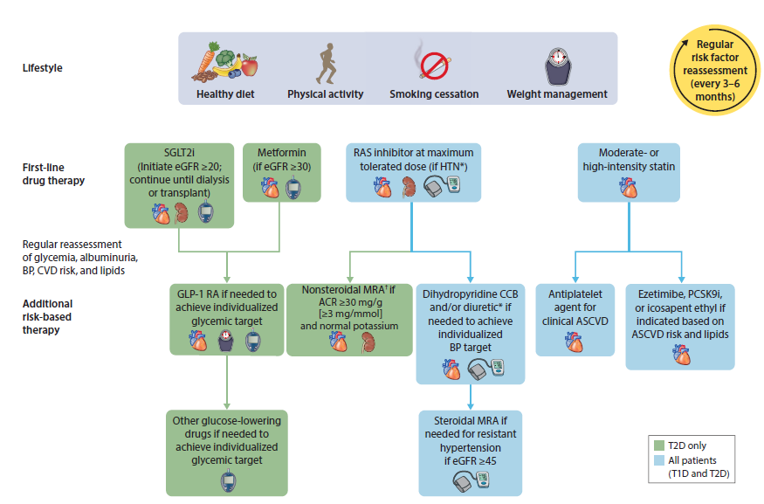
KDIGO 2022 guidelines recommend a holistic approach to improve outcomes in patients with CKD and T2D
Lifestyle
Lifestyle
First-line drug therapy
The KDIGO 2022 guidelines position finerenone in ALL patients with diabetes and CKD (UACR ≥30 mg/g)§
Regular reassessment of risk factors#
Additional risk-based therapy

Slide 11
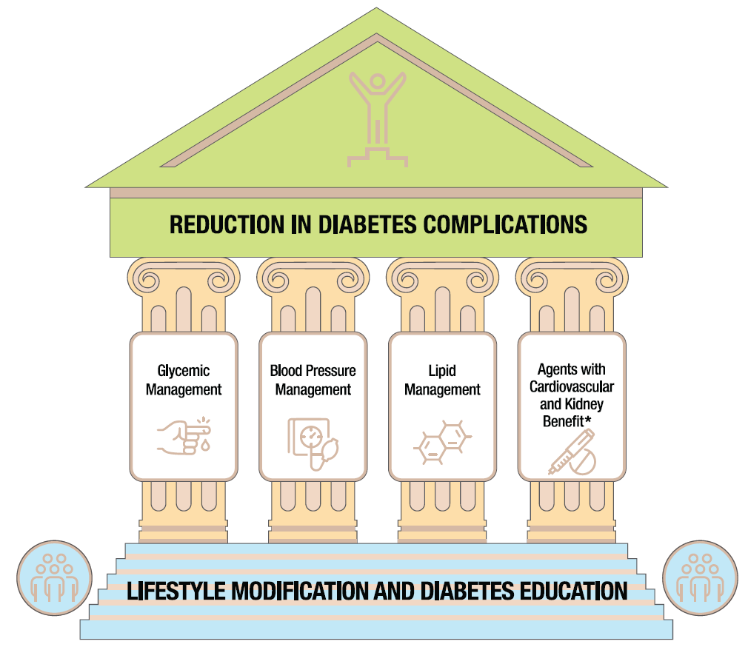
ADA 2023 recommendations for finerenone use
CKD and risk
management section¹
CV disease and risk management section³
Since January 2022, finerenone has been an ADA-recommended option for patients with CKD and T2D²
January 2023 update:
In June 2022, a recommendation was added which included evidence from trials of medication effects on heart failure and CV and CKD outcomes in patients with T2D⁴
January 2023 update:
A
Recommendation 11.5d:
‘In people with CKD and albuminuria who are at increased risk for CV events or CKD progression, a nonsteroidal MRA shown to be effective in clinical trials is recommended to reduce CKD progression and CV events’¹
A
Recommendation 10.43:
‘For people with T2D and CKD with albuminuria treated with maximum tolerated doses of ACE inhibitors or ARB, addition of finerenone is recommended to improve CV outcomes and reduce the risk of CKD progression’³
Adapted from: American Diabetes Association. Diabetes Care 2023;46;S158–S190
Recommendations based on evidence from the FIDELIO-DKD trial, FIGARO-DKD trial and the FIDELITY pooled analysis^{1,4}

Slide 12
A consensus report from the ADA and KDIGO on the management of CKD in T2D was published in October 2022
Key focus of report
Screening and diagnosis (screening for CKD with eGFR and UACR)
A holistic approach including treatment targets and pharmacotherapy
Comprehensive patient care
Finerenone consensus statement
A nonsteroidal MRA with proven kidney and CV benefit is recommended for patients with T2D, eGFR ≥25 ml/min/1.73 m², normal serum [K⁺], and albuminuria (ACR ≥30 mg/g) despite maximum tolerated dose of RASi
Statements were based on the FIDELIO-DKD and FIGARO-DKD studies and the FIDELITY pooled analysis

Slide 13
Summary
Finerenone is a selective nonsteroidal MRA that has been shown to provide CV and kidney benefits in patients with CKD and T2D^{1,2}
Major clinical guidelines recommend finerenone as a therapeutic option to reduce CKD progression and CV events in people with CKD and T2D^{3,4}
Through the ADA/KDIGO 2022 Consensus Statement,⁵ there is now a general inter-specialty agreement on a comprehensive approach for the management of CKD in T2D
Guideline-recommended use of finerenone in patients with CKD and T2D is independent of SGLT-2i use

